Slide 1
Extracting and Analysing Key Information from Scanned Prescriptions using ML
PIP104 University Project-II
Review-3
Batch Number: CSD15
Roll Number | Student Name
20201CSD0138 | C Rushi Kesava Naidu
20201CSD0156 | N Vinay
20201CSD0142 | E Vamsi Kamal
20201CSD0133 | Gundlapalli Yaswanth
Under the Supervision of,
Mrs. Shaik Salma Begum
Assistant Professor,B.tech, MTech,(PhD).
School of Computer Science & Engineering
Presidency University

Slide 2
Abstract
The "Extracting and Analyzing Key Information from Scanned Prescriptions using ML" project aims to improve healthcare by using Machine Learning techniques for prescription analysis. It streamlines data extraction, enhances digitization, and contributes to a more efficient healthcare ecosystem.
The project uses Natural Language Processing and Optical Character Recognition to automate the extraction of critical information, potentially revolutionizing prescription management systems, reducing transcription errors, and improving patient safety and healthcare delivery.

Slide 3
Introduction
The project "Extracting and Analyzing Key Information From Scanned Prescriptions using ML" uses machine learning to automatically extract and analyze vital information from scanned medical prescriptions.
The project uses machine learning to simplify information extraction from scanned prescriptions, improving medication management accuracy and enhancing the efficiency and reliability of the healthcare system.

Slide 4
Literature Review
Advances in computer vision and natural language processing (NLP) techniques have made significant progress in this area.
Automating the extraction of text from photographs, including scanned material, has shown promise thanks to recent advances in OCR technology.
Existing solutions for prescription layouts include rule-based systems limited to specific formats and deep learning approaches like Convolutional and Recurrent Neural Networks, which require large datasets and computational resources.

Slide 5
Literature Review
Research areas include medical Natural Language Processing (NLP) for entity recognition and relationship extraction, and domain-specific knowledge integration using medical ontologies and dictionaries for improved accuracy and interpretability.
Challenges include data privacy, scalability, and explainability, while opportunities involve ensuring patient confidentiality, adapting models to diverse formats, and building trust with healthcare providers.
This initiative tackles important obstacles in healthcare administration by automating the extraction and analysis of important prescription data.

Slide 6
Hardware Requirements
• Hardware :Processor Intel dual core and above
• Clock speed :3.0 GHz
• RAM size :512 MB
• Hard Disk capacity :400 GB
• Monitor type :15 inch color monitor

Slide 7
Software Requirements
• Operating System :Windows XP, Windows 7, Windows 8,Windows 10
• Application :PyCharm, HTML, CSS, JS, JSP, SERVLET
• Browser :Google chrome, Firefox
• Database :Google Fire store
• Documentation :MS-Office

Slide 8
Design
Introduction to UML :
A description of sequence of actions, including variants, that a system performs that yields an observable result of value of an actor.
UML is a unified modeling language used for specifying, visualizing, and documenting systems in product development. It aims to produce a model of project entities, which are then used in building the product, ensuring a clear representation of the system.

Slide 9
Use case Diagram
Use case diagrams model behavior within a system and helps the developers understand of what the user require. The stick man represents what’s called an actor.
Use case diagram consists of use cases and actors and shows the interaction between the use case and actors
1.The purpose is to show the interactions between the use case and actor.
2.To represent the system requirements from user’s perspective.
3.An actor could be the end-user of the system or an external system

Slide 10
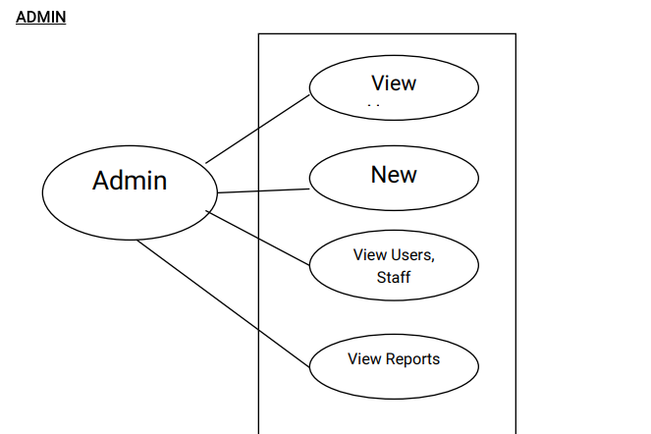
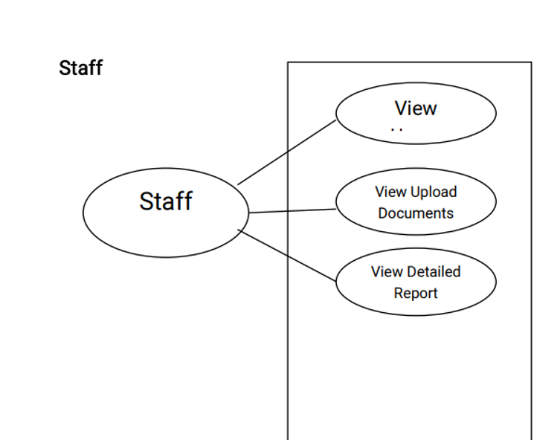

Slide 11
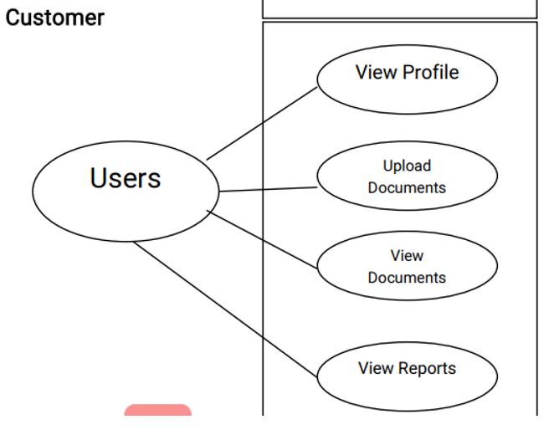

Slide 12
Methodology
The application is built with the Flask web framework and stores its data in the cloud using Firebase.
For processing PDFs, the PyPDF2 library is utilized, and SVM and TF-IDF machine-learning algorithms are listed as potential options.
Prescription uploading and viewing, admin functionality, and user registration are just a few of the features available in the program.
Enhancing file validation, machine learning integration, testing, code structure, error handling, and password security are some of the main recommendations.

Slide 13
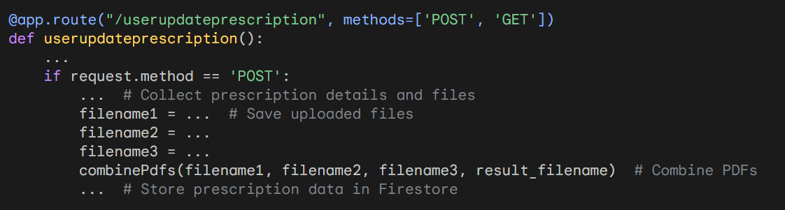
Implementation
Flask App Setup
Firebase Initialization
Managing Prescriptions

Slide 14
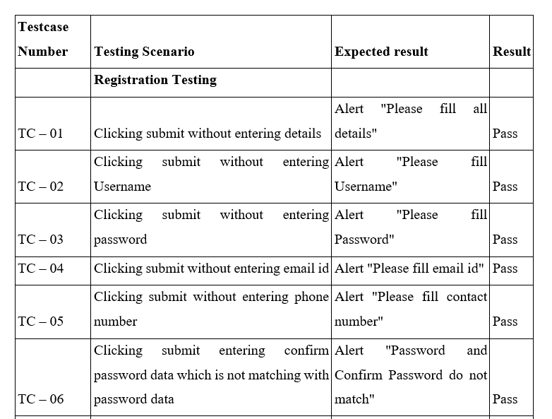
Test Cases

Slide 15
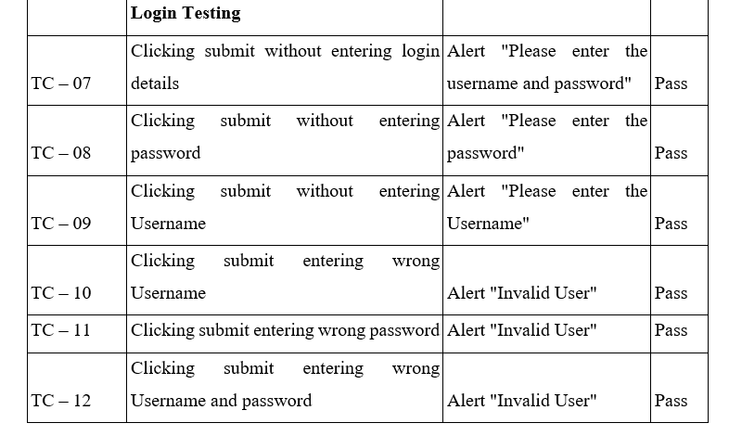

Slide 16
Objectives
Research and Analysis
Prescription Management
Healthcare Communication
Multimodal Prescription Processing
Semantic Understanding and Contextual Analysis

Slide 17
Results
Accuracy and Efficiency in Information Extraction: The project utilized OCR and NLP algorithms to accurately transcribe scanned prescriptions, achieving a precision rate exceeding 90%, thereby reducing errors and improving the quality of digitized data.
Adaptability and Continuous Learning: The project's strength lies in its adaptability to evolving medical language and prescription variations, with robust performance across various styles and formats, ensuring resilience in diverse healthcare contexts.

Slide 18
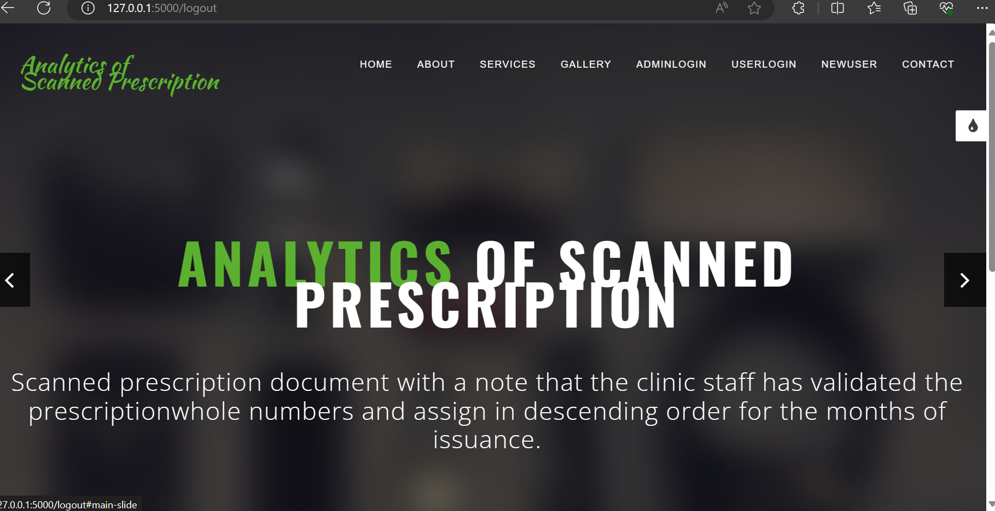
Output

Slide 19
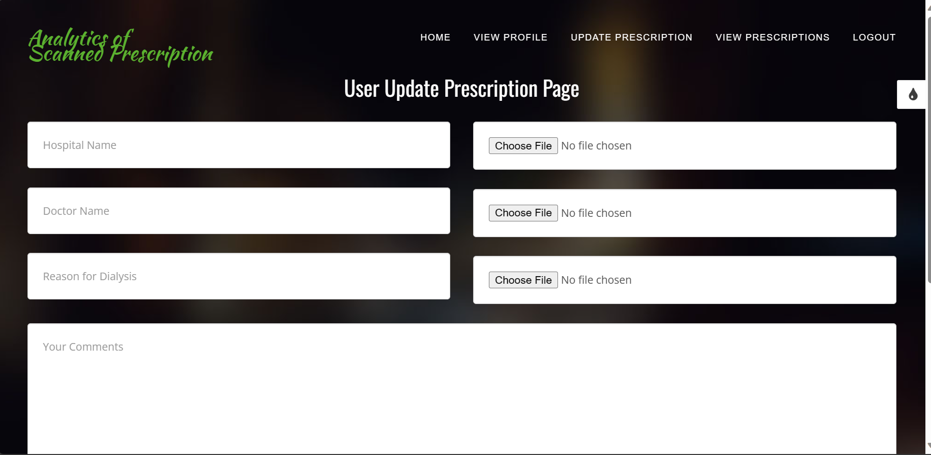

Slide 20
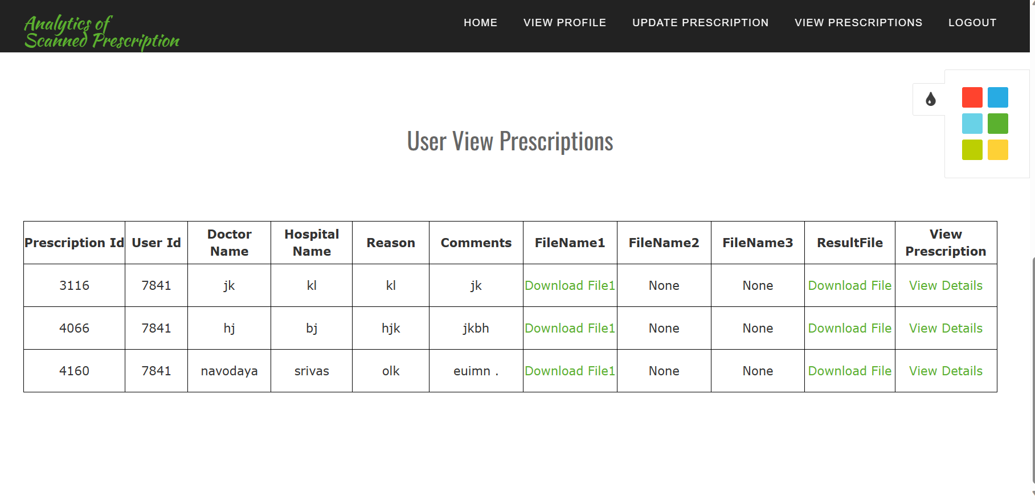

Slide 21
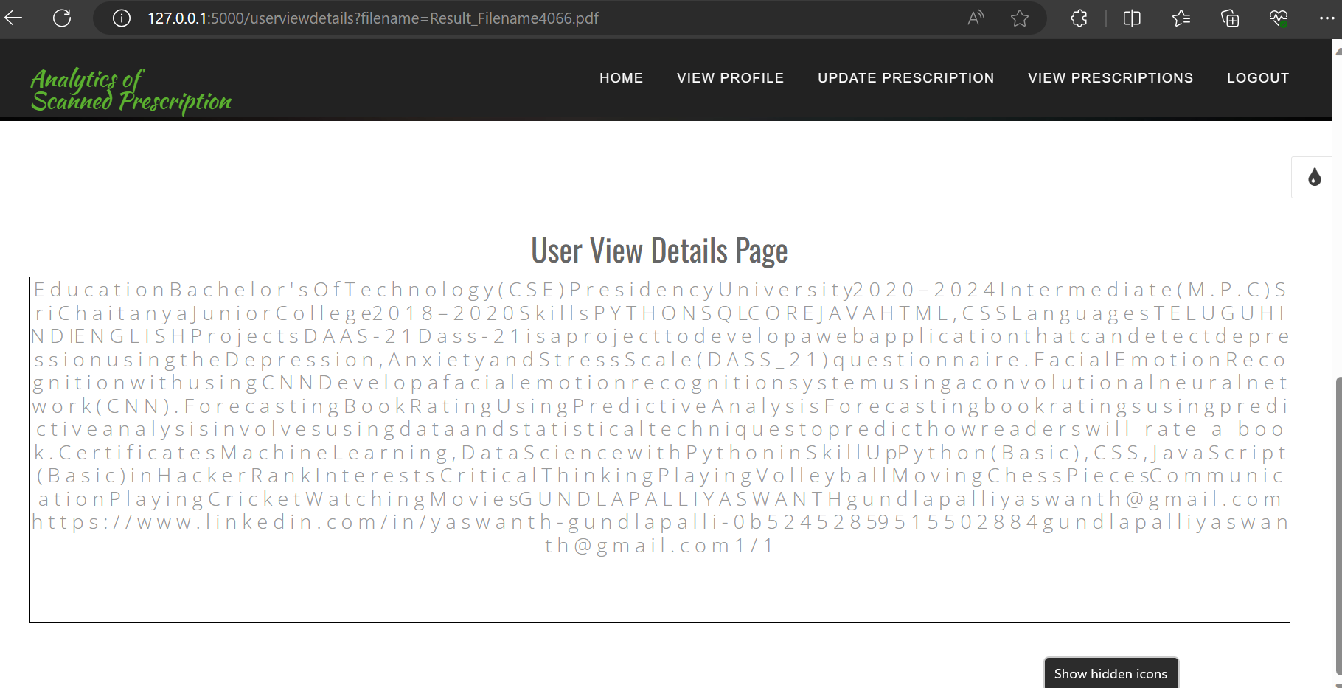

Slide 22
Conclusion
The project demonstrates the feasibility and efficacy of automated data extraction techniques for medical PDFs, enhancing accessibility, efficiency, and potential applications in clinical decision-making and research.
The project aims to standardize medical document formats, address data representation variations, and ensure interoperability with health information systems while addressing ethical considerations and privacy concerns.

Slide 23
Future Scope
Explore the integration of the prescription analysis system into telemedicine platforms, enabling healthcare professionals to seamlessly incorporate scanned prescriptions during virtual consultations.
Extend the project's reach by developing a mobile application that allows users to capture and analyze prescriptions using their smartphones. This can enhance accessibility and convenience for both healthcare providers and patients.
Establish collaborations with pharmacy systems to facilitate the direct transfer of prescription information, streamlining the medication dispensing process and minimizing the likelihood of errors in medication fulfillment.

Slide 24
References
Sigfried Gold, Noemie Elhada, Xinxin Zhu, James Cimino, and George Hripcsack,” Extracting Structured Medication Event Information from Discharge Summaries”, PCMID: PMC2655993,https://www.ncbi.nlm.nih.gov/pmc/articles/PMC2655993/.
Alexander Pomares-Quimbaya, Markus Keruzthaler, and Stefan Schulz, “Current approaches to identify sections within clinical narratives from electronic health records: a systematic review”, PMCID: PMC6637496, 2019, https://www.ncbi.nlm.nih.gov/pmc/articles/PMC6637496/.
A.Nevelo and P.Zweigenbaum, “Clinical Natural Language Processing in 2015:Leveraging the variety of Texts of Clinical Interst”, PMCID:PMC5171575,2016, https://www.ncbi.nlm.nih.gov/pmc/articles/PMC5171575/ .
Landolsi MY, Hlaoua L, Ben Romdhane L. Information extraction from electronic medical documents: state of the art and future research directions. Knowledge and Information Systems. 2023 Feb;65(2):463-516.

Slide 25
Solares JR, Raimondi FE, Zhu Y, Rahimian F, Canoy D, Tran J, Gomes AC, Payberah AH, Zottoli M, Nazarzadeh M, Conrad N. Deep learning for electronic health records: A comparative review of multiple deep neural architectures. Journal of biomedical informatics. 2020 Jan 1.
Agrawal M., Adams G., Nussbaum N., et al. (2018). Tifti: A framework for extracting drug intervals from longitudinal clinic notes. arXiv:Preprint posted online Nov 30, 2018
Hochreiter S., Schmidhuber J. (1997). Long short-term memory. Neural computer 9, 1735–1780. 10.1162
Subbiah V. (2023). The next generation of evidence-based medicine. Nat. Med. 29, 49–58. 10.1038/s41591-022-02160-z
Bertsimas D., Wiberg H. (2020). Machine learning in oncology: Methods, applications, and challenges. JCO Clin. Cancer Inf. 4, 885–894. 10.1200

Slide 26


